Slide 1
AS, MAX(), and AVG()

Slide 2
Overview
Using AS for aliasing columns
Calculating maximum values with MAX()
Calculating average values with AVG()
Avoiding INNER JOIN using subqueries

Slide 3
Table Structure Recap
Tables: students, courses, enrollments, grades
Relationships:
Students enroll in courses.
Students receive grades for course

Slide 4
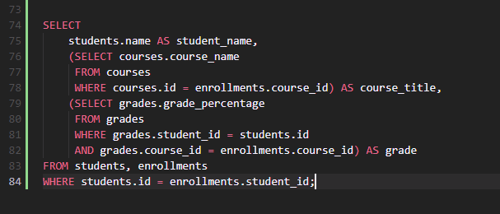
Using AS Without INNER JOIN
Notes:
SELECT students.name AS student_name, (SELECT courses.course_name FROM courses WHERE courses.id = enrollments.course_id) AS course_title, (SELECT grades.grade_percentage FROM grades WHERE grades.student_id = students.id AND grades.course_id = enrollments.course_id) AS grade FROM students, enrollments WHERE students.id = enrollments.student_id;

Slide 5
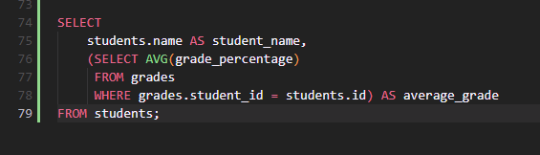
AVG() Without INNER JOIN
AVG()
Notes:
SELECT students.name AS student_name, (SELECT AVG(grade_percentage) FROM grades WHERE grades.student_id = students.id) AS average_grade FROM students;

Slide 6
Class Task: AVG(), MAX()
Average() Grade for Each Course
MAX() Grade for Each Course
MAX() for Each Student

